Slide 1
Web Technologies
Laravel Database Operations

Slide 2
Summary of Today’s Lecture
Laravel MySQL Database
SQL CRUD Operations
Sample SQL Queries
Laravel Database operations
Laravel Project – onlinefishmarket
Views
Routes
Controllers

Slide 3
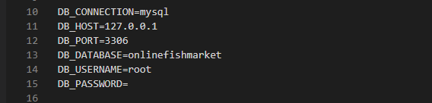
Laravel MySQL Database
With Laravel, we can connect to and manipulate databases. Whenever we create a project in the Laravel, Laravel automatically makes an entry in the .env file.
The default connection is with the mysql database with the database exactly similar to the <projectname>.
The LogIn credentials of the database are also the default values used in the phpMyAdmin interface.

Slide 4
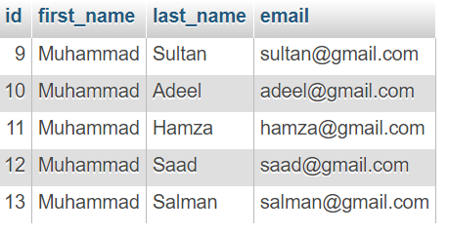
MySQL Database
MySQL is one of the most popular relational database system being used on the Web today.
It is freely available and easy to install, however if you have installed Wampserver it is already there on your machine.
MySQL database stores data into tables like other relational database. A table is a collection of related data, and it is divided into rows and columns.
Each row in a table represents a data record that are inherently connected to each other such as information related to a particular person, whereas each column represents a specific field such as id, first_name, last_name, email, etc.
The structure of a simple MySQL table that contains person's general information may look something like this:

Slide 5
CRUD Operations
SQL, the Structured Query Language, is a simple, standardized language for communicating with relational databases like MySQL.
With SQL you can perform any database-related task, such as creating databases and tables, saving data in database tables, query a database for specific records, deleting and updating data in databases.
The acronym CRUD refers to creating, reading, updating and deleting records in the database. It corresponds to INSERT, SELECT, UPDATE and DELETE queries of the SQL respectively.
Letter | Operation | MySQL Statement
C | Create | INSERT
R | Retrieve | SELECT
U | Update | UPDATE
D | Destroy | DELETE

Slide 6
INSERT Query Examples
/* Inserts a row in Customer Table */
INSERT INTO Customer (Name, Email, City) VALUES ('Ali', 'ali@comsats.edu.pk', 'Islamabad’);
/* Inserts a row in Fee Table */
INSERT INTO Fee (RegNo, ReceiptDate, Amount)
VALUES ('CIIT/FA19BCS/001/ISB', '2020-07-15', 80000);

Slide 7
SELECT Query Examples
/* display all columns and all rows */
SELECT * FROM recipe;
/* column names specified */
SELECT name, content
FROM recipe;
/* specify matching row(s) */
SELECT * FROM recipe
WHERE name = "Jello";
/* sort according to name */
SELECT * FROM recipe ORDER BY name;
/* obtain most recent recipe */
SELECT id FROM recipe ORDER BY creation
DESC LIMIT 1;

Slide 8
UPDATE Query Examples
/* modify column 'content' on all rows */
UPDATE recipe
SET content = "Mix ingredients";
/* replace "Drink" with "Beverage" (1st match) */
UPDATE category
SET name = "Beverage" WHERE name = "Drink“
LIMIT 1;
/* modify via unique id (most common) */
UPDATE recipe
SET content = "Stir ingredients";
WHERE id = 1;

Slide 9
DELETE Query Examples
/* delete all rows (you sure?) */
DELETE FROM book;
/* delete the first match */
DELETE FROM book
WHERE lastName = "Wesley"
LIMIT 1;
/* delete via id (most common) */
DELETE FROM book
WHERE id = 1;

Slide 10
Laravel Database Operations
In the simplest form, there are three steps for performing CRUD operations in Laravel.
Defining Routes
They will be used for defining routes corresponding to URLs specified by the user in the browser’s address bar or generated within the project. For Example, below is one such route;
Route::get('/index','App\Http\Controllers\UserController@index');
Defining Controller
In the created controller class, we will write methods that will perform CRUD operations in the database. The data will be passed to views.
function index() {
return view('index');
}
Defining Views
<html><head> <title>My first PHP Website</title> </head>
<body>
<?php echo "<p>Hello World!</p>"; ?>
<a href="/login"> Click here to login</a> <br>
<a href="/register"> Click here to register </a>
</body>
</html>

Slide 11
Laravel Project - onlinefishmarket
Views
index.blade.php
register.blade.php
login.blade.php
home.blade.php
edit.blade.php
delete.blade.php
Routes
Route::get('/index','App\Http\Controllers\UserController@index');
Route::get('/register', 'App\Http\Controllers\UserController@register');
Route::post('/register', 'App\Http\Controllers\UserController@store');
Route::get('/login', 'App\Http\Controllers\UserController@login');
Route::post('/login', 'App\Http\Controllers\UserController@match');
Route::get('/home', 'App\Http\Controllers\UserController@home');
Route::post('/add', 'App\Http\Controllers\UserController@storeFish');
Route::get('/edit', 'App\Http\Controllers\UserController@viewFish');
Route::post('/update/{id}', 'App\Http\Controllers\UserController@updateFish');
Route::get('/delete', 'App\Http\Controllers\UserController@deleteFish')->name('delete');
Controllers
Live in the Visual Studio along with their implementation.

Slide 12
Summary of Today’s Lecture
Laravel MySQL Database
CRUD Operations
Sample SQL Queries
Laravel Database operations
Laravel Project – onlinefishmarket
Views
Routes
Controllers

